Slide 1
Application of Big Data and AI in Investment Management
Ken Liu

Slide 2



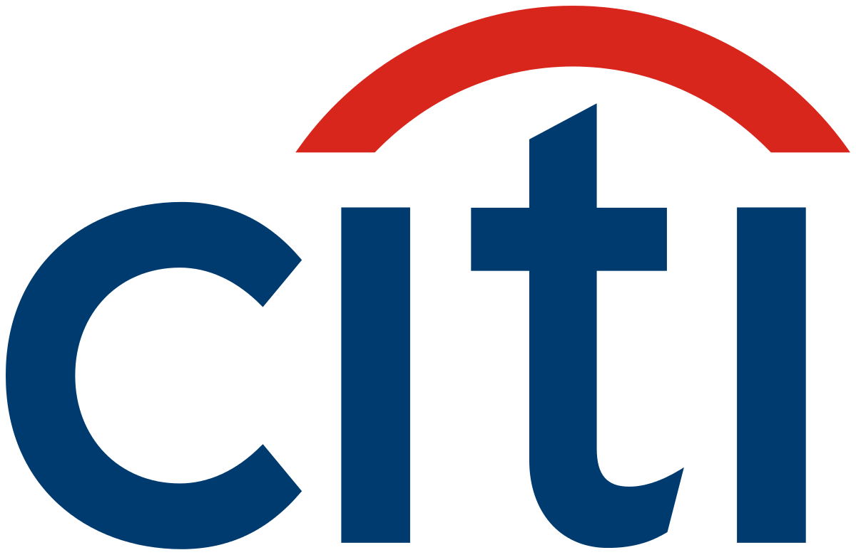


My Background
Study Computer Science
iBanks Algo trade technologist
Startup on Quant Trading, Big Data and AI

Slide 3
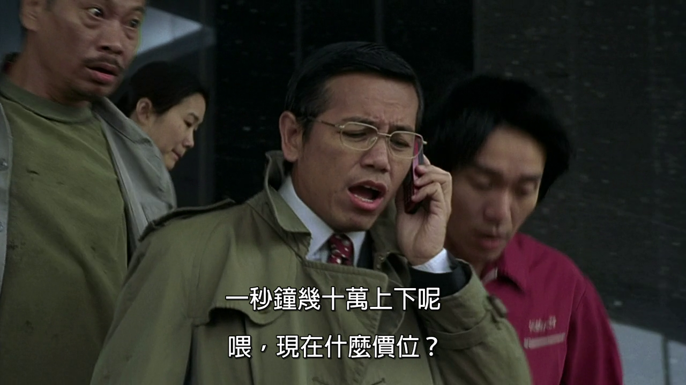
My Work
Sub-header/text/chart/table

Slide 4
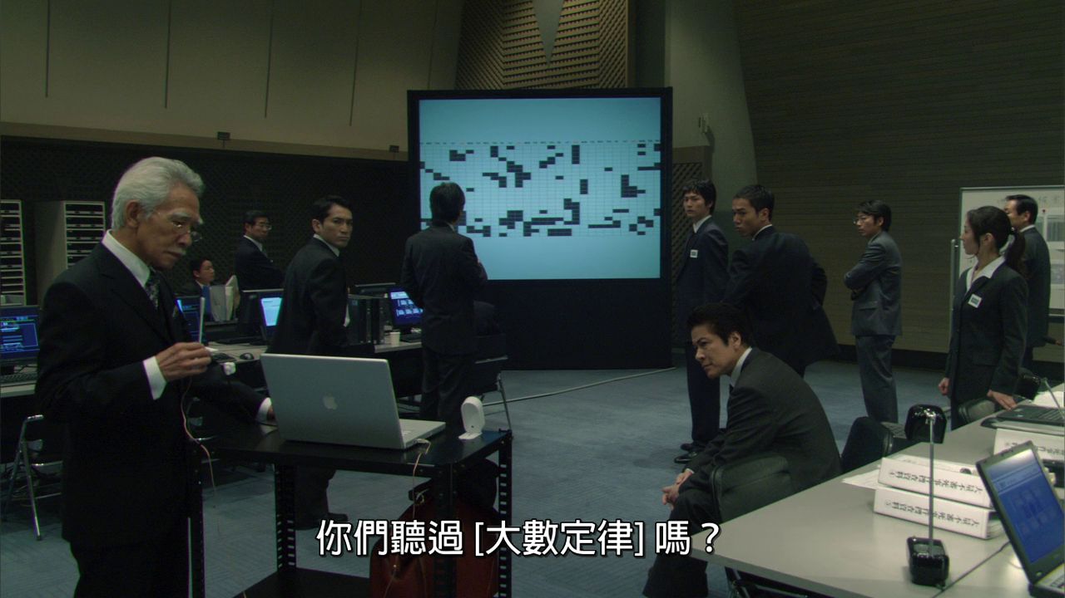
My Work
Sub-header/text/chart/table

Slide 5


Key Themes
Portfolio (what do buy)
Stock Pickings
Fundamental: values, prospects
Quantitative: statistics, models
Trading (how to buy)
Algorithmic Trading
HFT (High Frequency Trading)
Program Trading

Slide 6
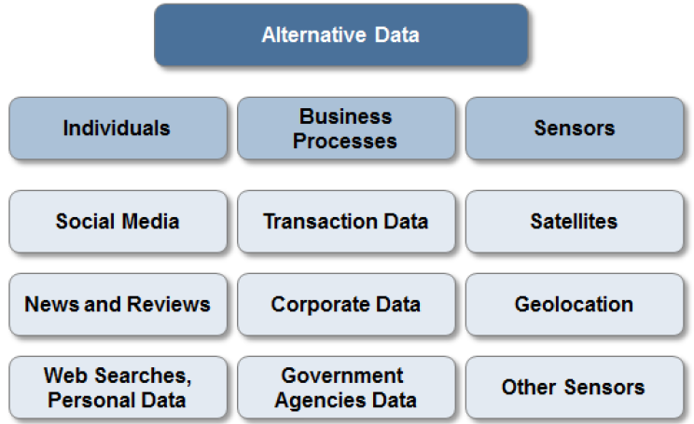
Data, Data, Data….

Slide 7
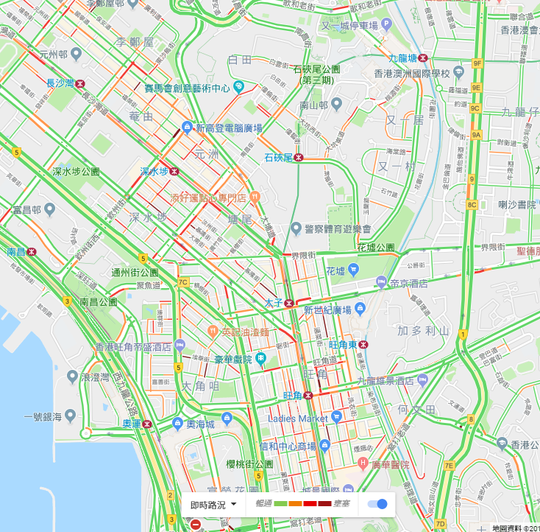
Individuals: Digital Footprints
How Google knows the traffic ?
1. From HK Transport Department ?
2. From Satellite Images ?
3. From You ?
Google Map traffic analyzing the GPS-determined locations transmitted to Google by a large number of mobile phone users. By calculating the speed of users along a length of road, Google is able to generate a live traffic map https://en.wikipedia.org/wiki/Google_Traffic

Slide 8
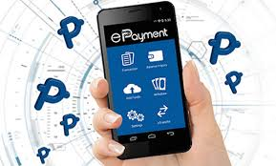
Business Processes
Public agencies (e.g. federal and state governments) https://data.gov.hk/en/
Commercial transactions (including e-commerce such as AliPay and WeChat, credit card spending, exchange transaction data)
Private agencies (e.g. industry specific supply chain data, intra-day tick data from the exchange)
Other ideas:
Amazon: track the best sales products and break down the underlying raw material for investing
Gov open data (such as pollution index, beach water quality): track health for pharmaceutical stocks

Slide 9
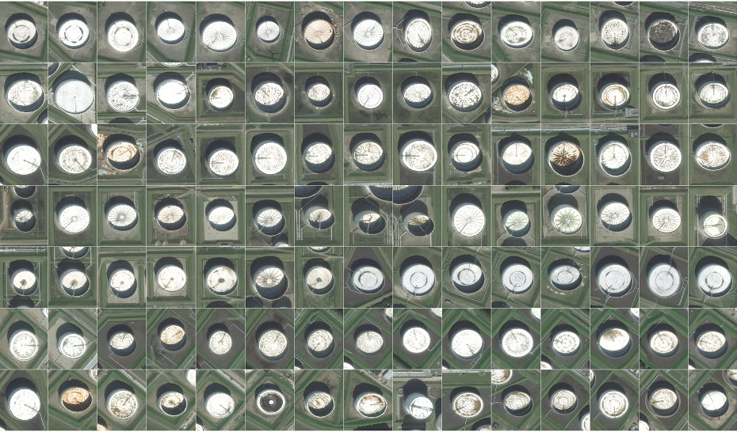
Satellite image: Oil Reserve
Oil reserves are often stored in floating tanks around the world, whose lid rises and falls with increasing or decreasing storage. With the rising and falling height, the crescent-shaped shadows cast by the sun also change shape. By tracking these shape changes (AI techniques), Orbital Insights predicts oil inventory levels.
https://www.wired.com/2015/03/orbital-insight/

Slide 10
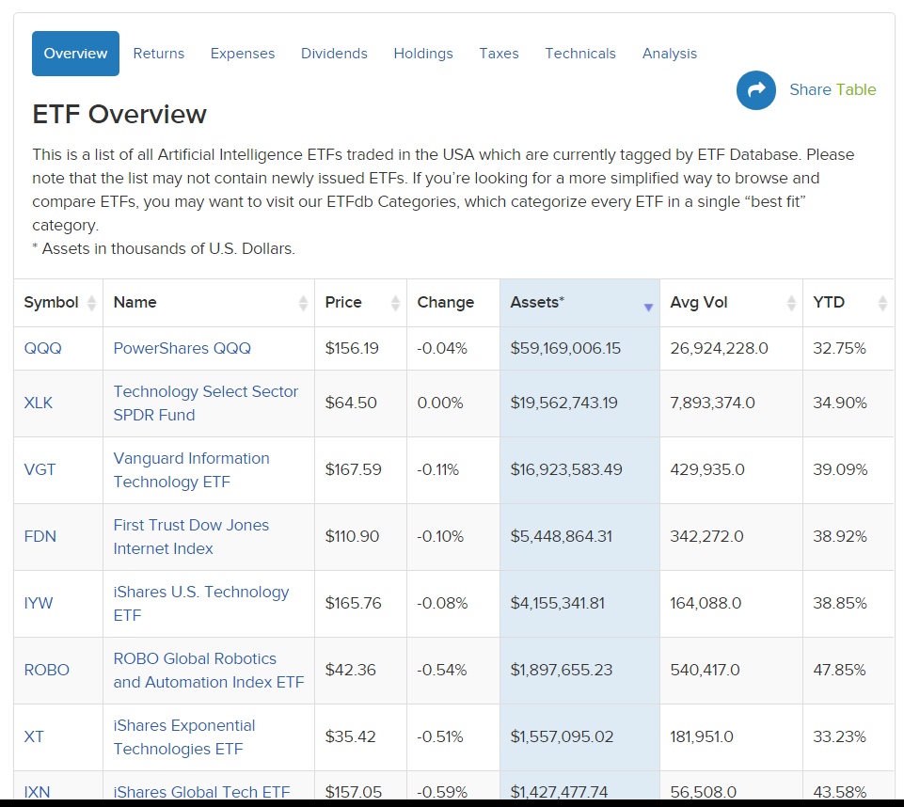
Robo-Advisor: AI ETF
Leverage big & alternative data source
Text: Social Media, News
Images: satellite image on oil fields
Videos: road cameras of cars

Slide 11
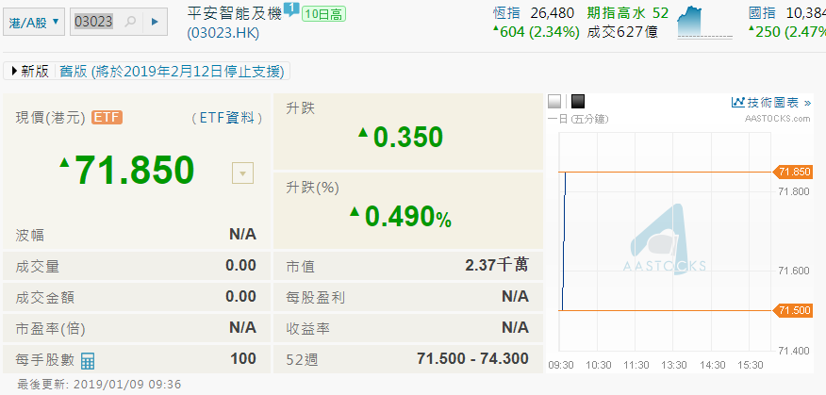
Example: AI ETF
Ping An Nasdaq AI and Robotics ETF (3023.HK)
an exchange-traded fund incorporated in Hong Kong. The fund seeks to track the performance of Nasdaq CTA Artificial Intelligence and Robotics Index.

Slide 12
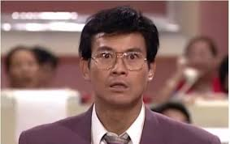
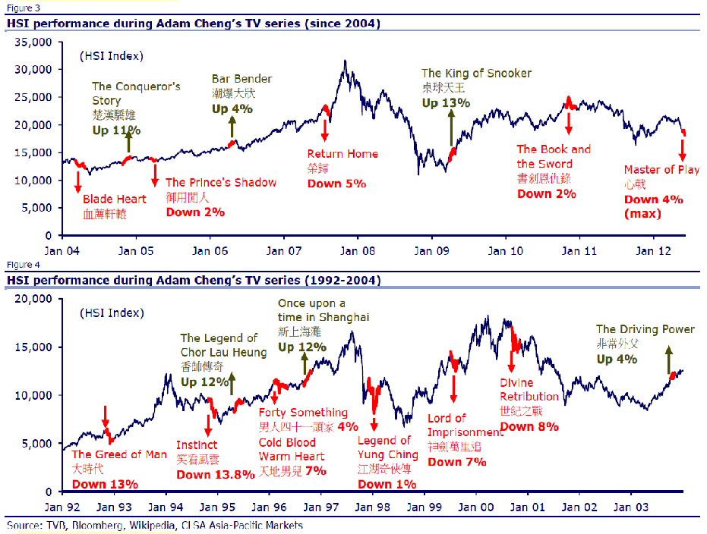
Sentiment Analysis
Adam Cheng / Ting Hai Effect
Notes:
e.g. People over worry about the typhoon coming and insurance stocks are too over-sold

Slide 13
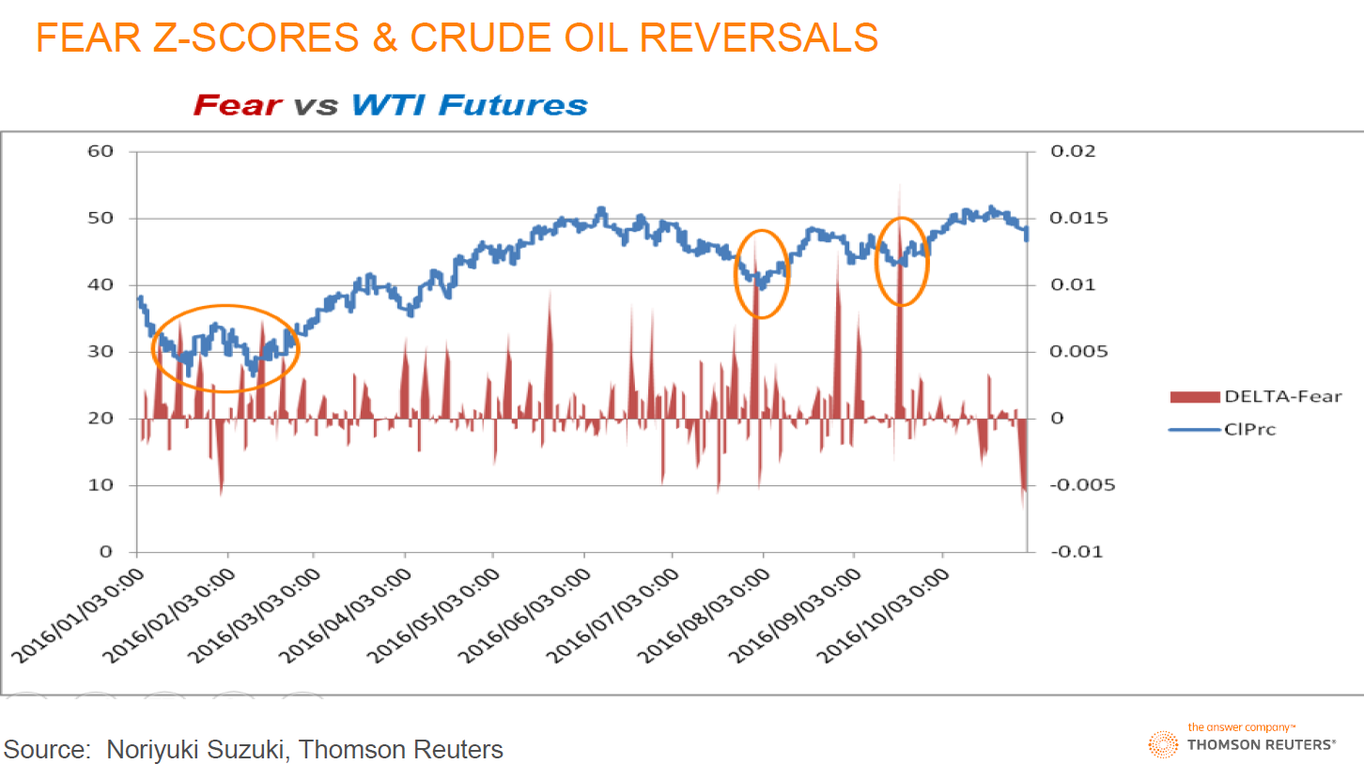
Thomson Reuters MarketPsych Indices (TRMI)

Slide 14
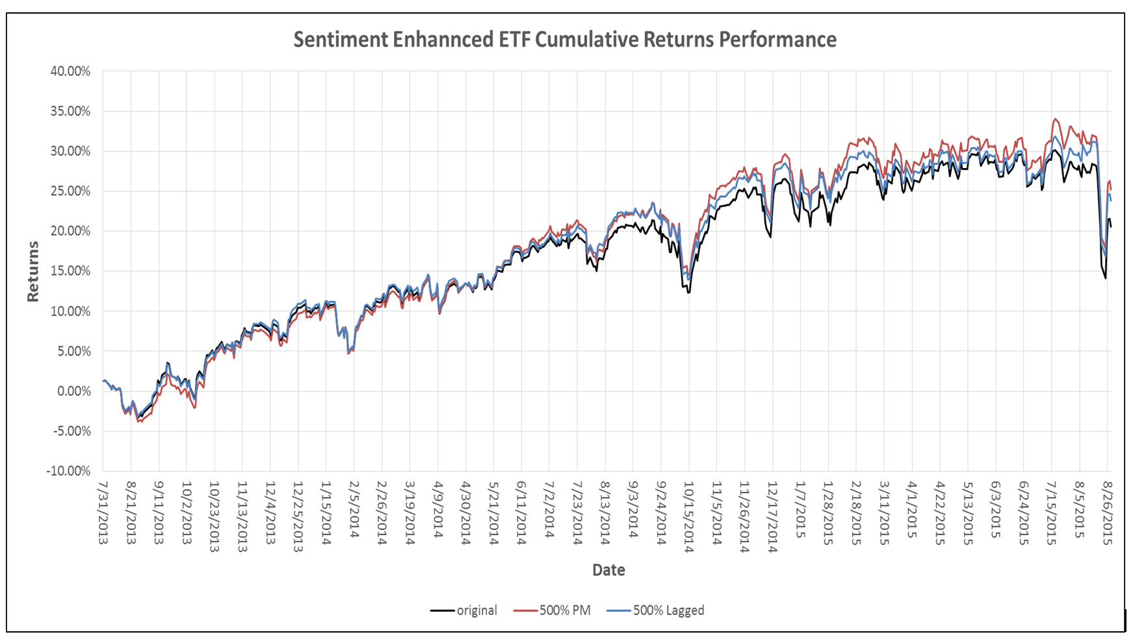
Smart Beta: Sentiment Enhanced ETF
Using the social media sentiment levels of individuals ETF constituents to rebalance the weights of the constituents in the ETF while keeping the Assets under Management constant
http://isentium.com/charts//

Slide 15
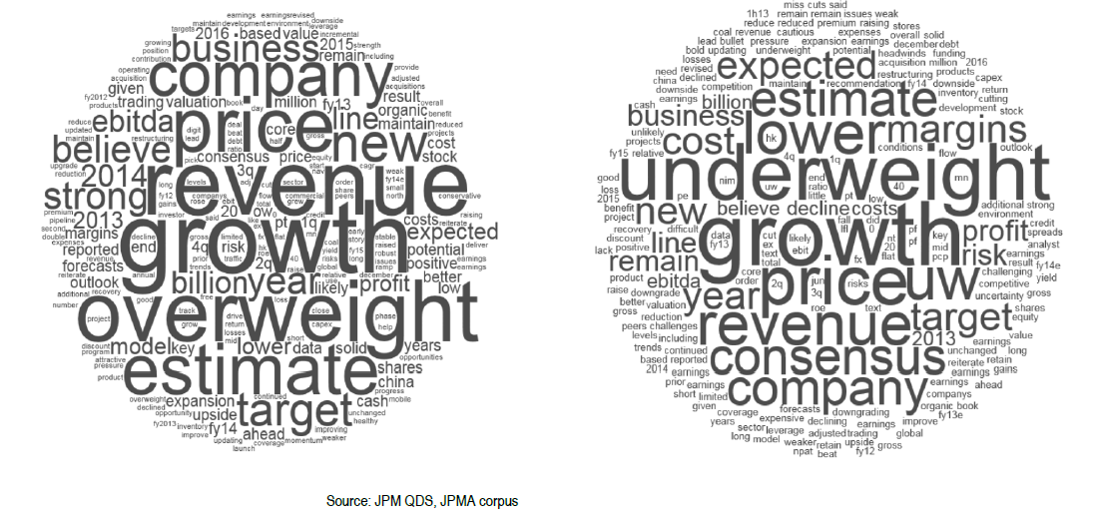
Word2Vec – Sentiment Analysis

Slide 16
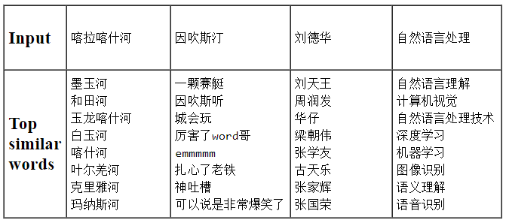
Word2Vec – Chinese Language
Tencent AI Lab Embedding Corpus for Chinese Words and Phrases

Slide 17
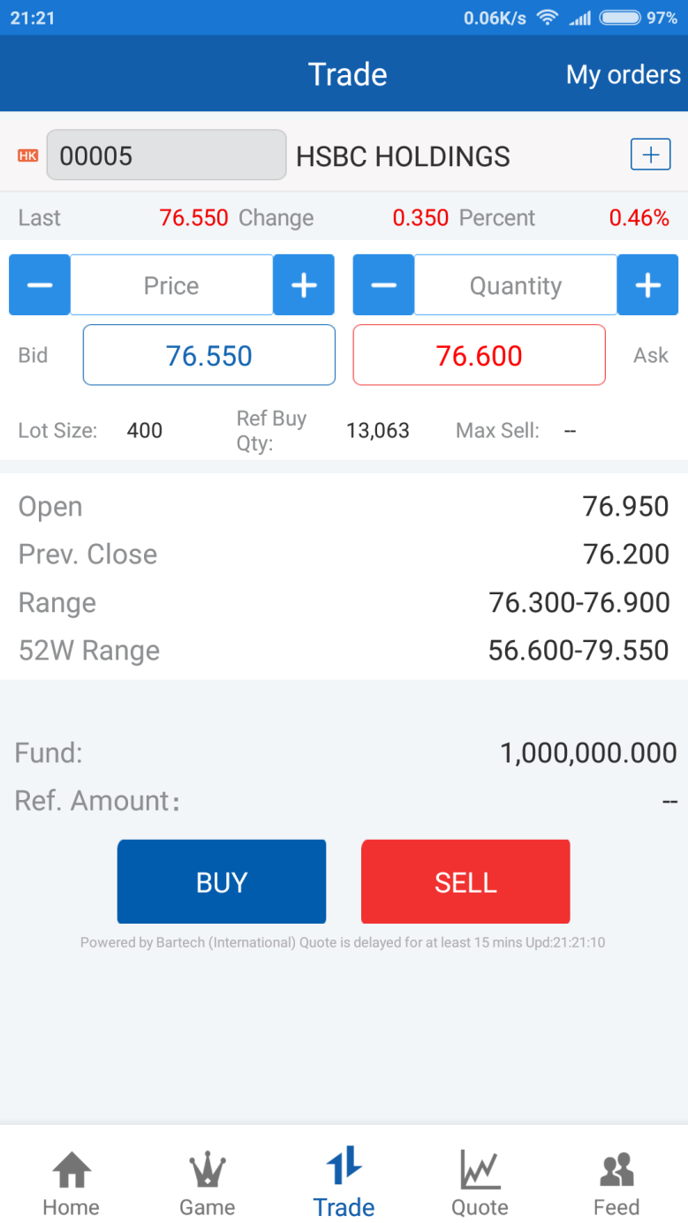
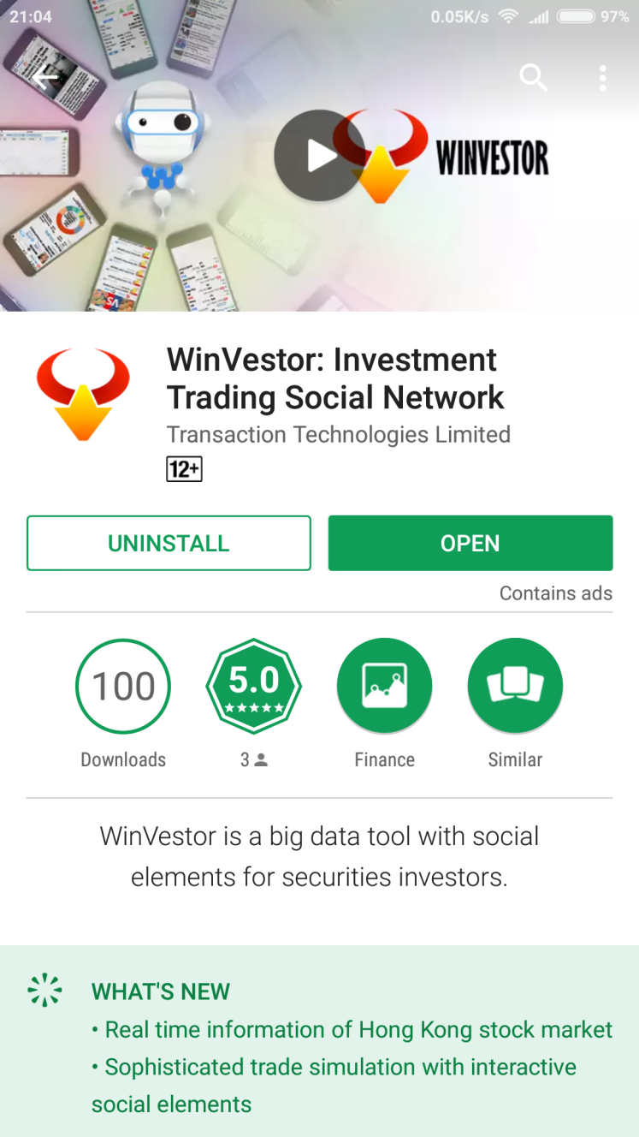
Social Trading
WinVestor
Download from App or Play Store
News Analytics
Market Data
Trading Games

Slide 18
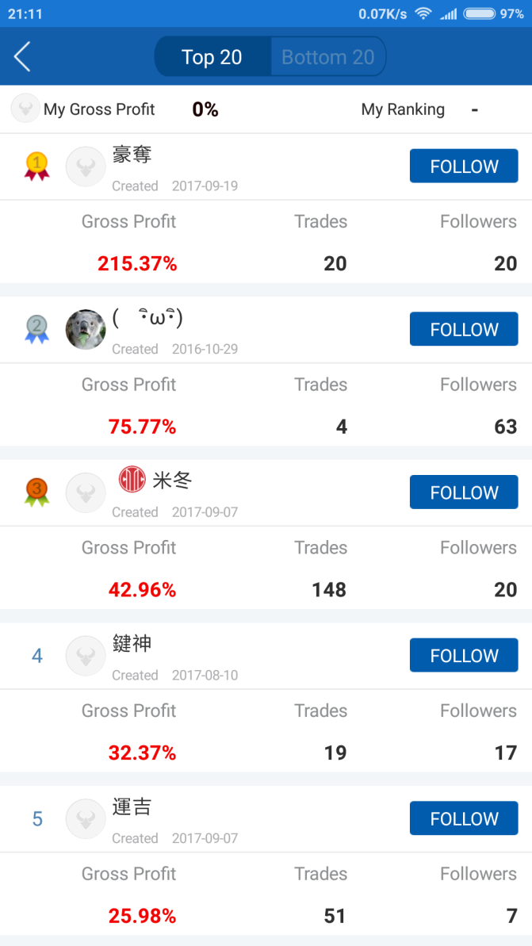
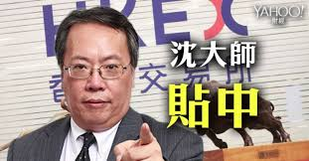
Example: Social Trading
Learn user trading patterns and behaviors
Money-making users can get paid for viewing their profitable portfolios and transaction notifications

Slide 19
Short Term Price Movement
Order Book Imbalance: the average ratio between the best bid and best ask size over a 1-min window. If the average bid size is larger than the ask size (hence a positive ratio), like the example below, it indicates the price is more likely to go up. Vice versa, the price is more likely to go down.
1min-Order Book-Imbalance = Avg (Log(Best BidSize/ Best AskSize))
Options: We can take into account the first few levels (for example 3 levels) of the order book while the top level of the book will have higher weighting. The 1-min duration can also be customized to a shorter or longer duration.
Size | Bid | Ask | Size
1,000,000 | 9.5 | 9.6 | 20,000
500,000 | 9.4 | 9.7 | 50,000
700,000 | 9.3 | 9.8 | 80,000
Notes:
Ask why taking log – because the asymmetry of +ve and –ve ratio

Slide 20
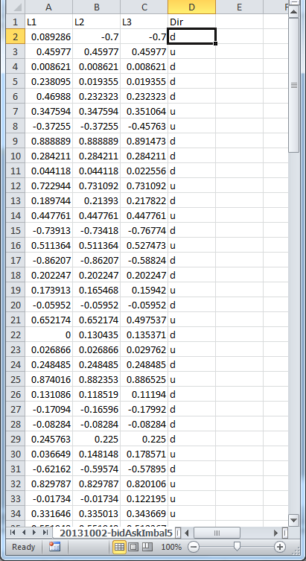
Short Term Price Movement
Use Decision Tree to predict short-term stock (5.HK) movement (go up or down) from Order Book Imbalance (OBI) data.
L1: Level-1 OBI
L2: Level-2 OBI
L3: Level-3 OBI
Dir: Direction - u(up) , d (down)

Slide 21
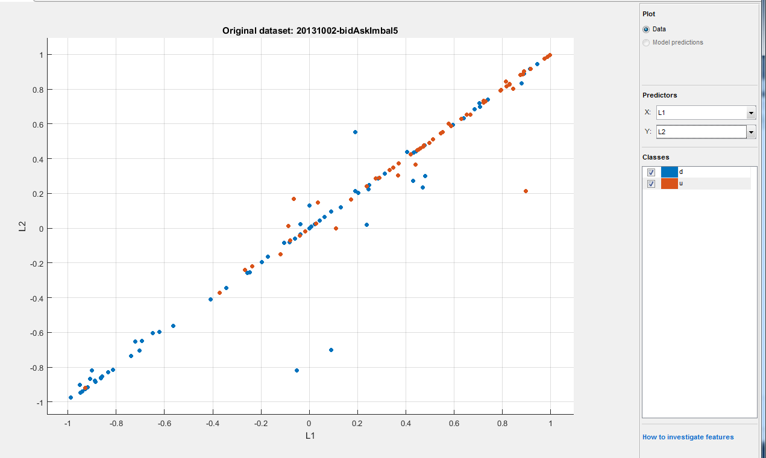
Short Term Price Movement
Visualize the data: plotting Level-1 OBI and Level-2 OBI
Brown dots: stock going up, Blue dots: stock going down
More Brown dots (up) when both Level-1 OBI and Level-2 OBI are positive and vice versa

Slide 22
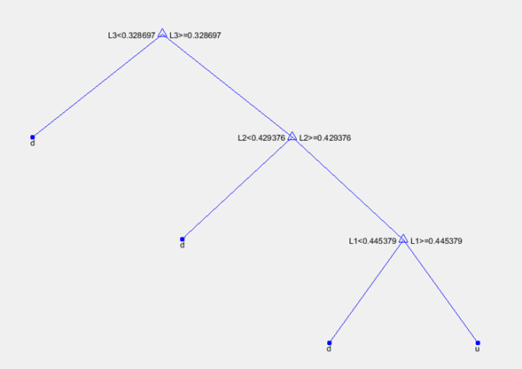
Short Term Price Movement
Decision Tree training results for this Stock to be more likely to go up when:
Level-1 OBI > 0.445379 and Level-2 OBI > 0.429376 and Level-3 OBI > 0.328697

Slide 23
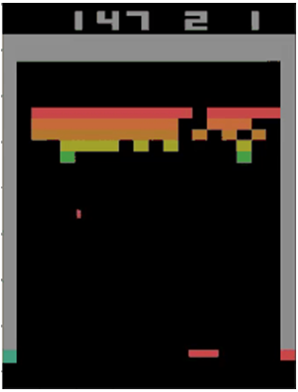
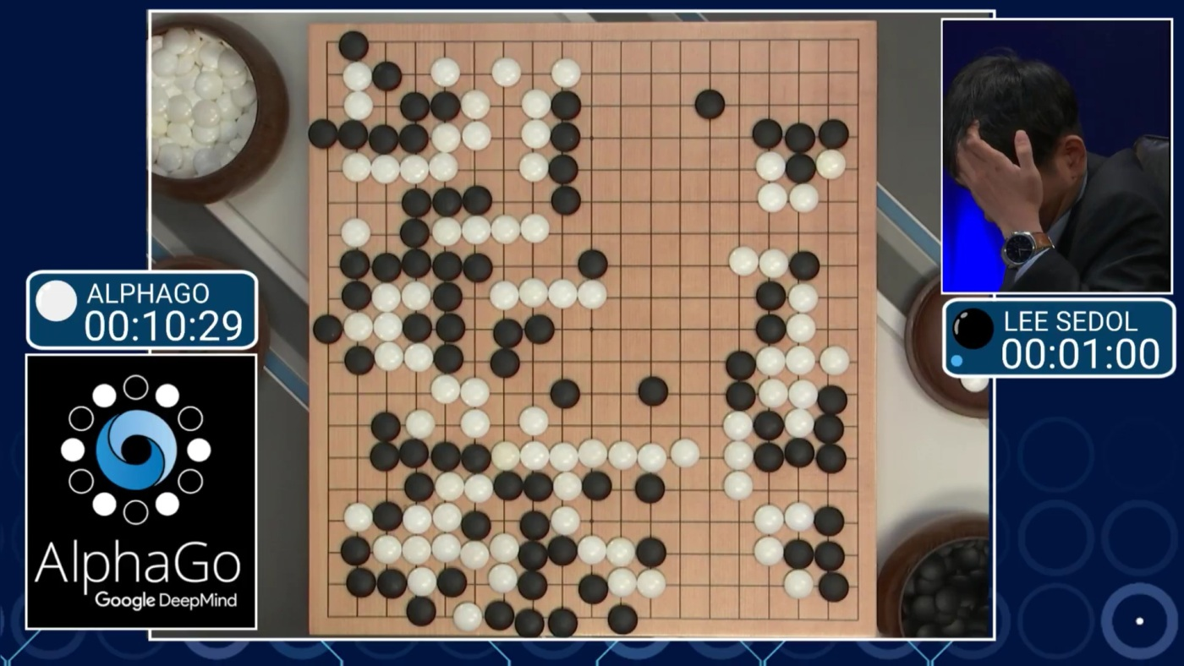
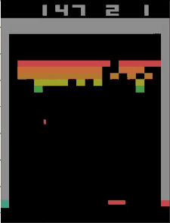
Reinforcement Learning
https://cs.stanford.edu/people/karpathy/convnetjs/demo/rldemo.html
Tunneling !

Slide 24
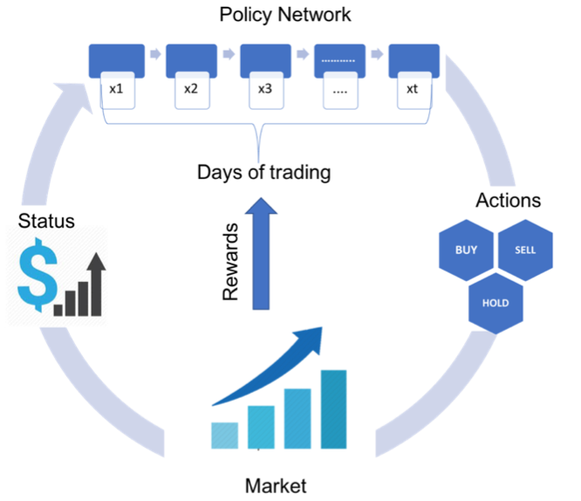
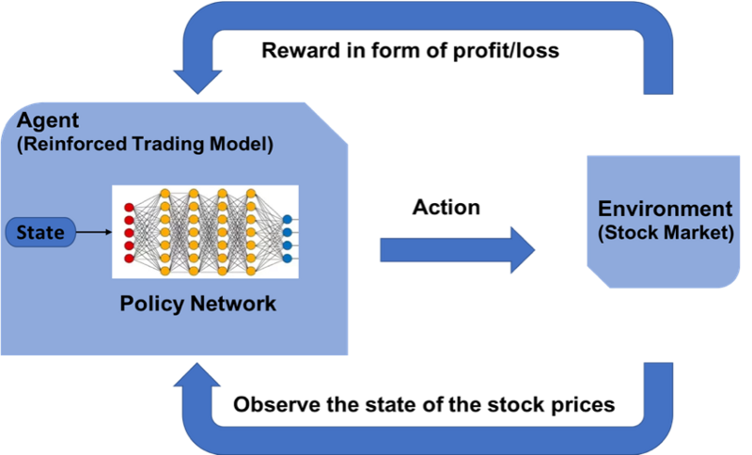
Reinforcement Learning on Trading

Slide 25
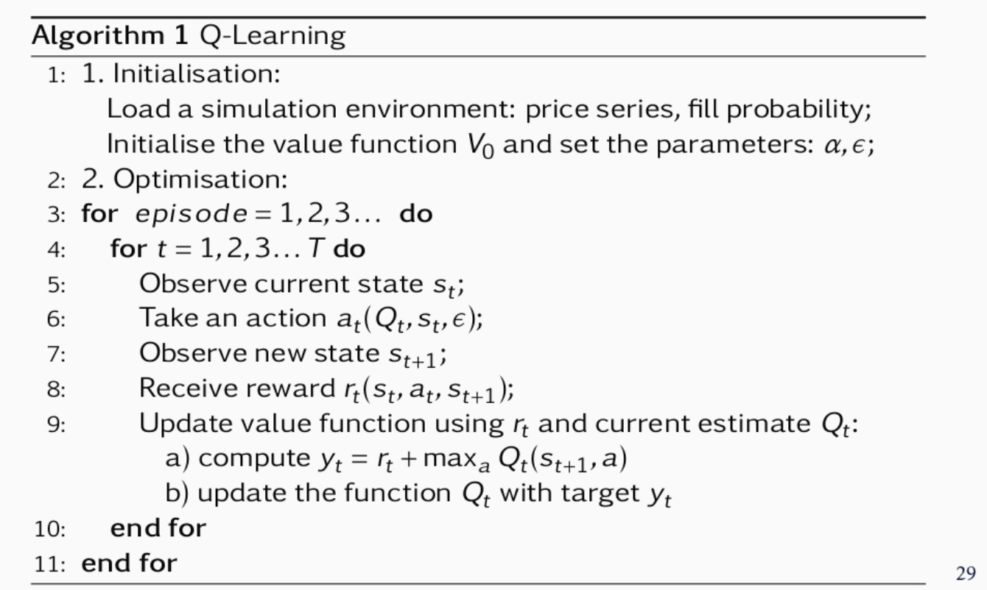
Reinforcement Learning on Trading
JP Morgan LOXM
Learns to perform the best action (choose optimal price, duration and order size ) based on market conditions
State: price series, spread cost, fill probability, size placed, elapsed time, %progress
Rewards: immediate rewards (price spread) and terminal (end of episode) rewards like completion, order duration and market penalties (negative rewards that punish the agent)

Slide 26
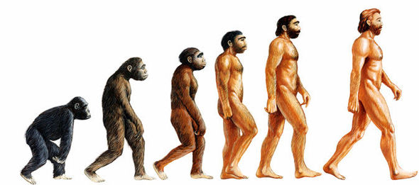
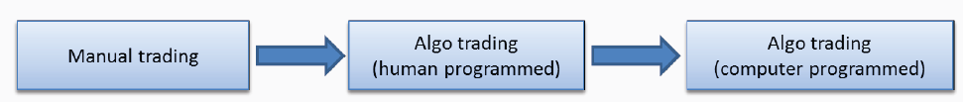
Reinforcement Learning on Trading
AI Traders -> Repeatedly Doing Backtest -> Find the Optimal Strategies
It is a very black box approach and may not be welcomed by compliance and regulators

Slide 27

Thank you

